Slide 1
Installation Guide
(Eclipse Plug-in － PMD
on Eclipse 3.5)
2009. 09. 25
CODELABOR
Shin Sang Jae (codelabor@gmail.com)

Slide 2
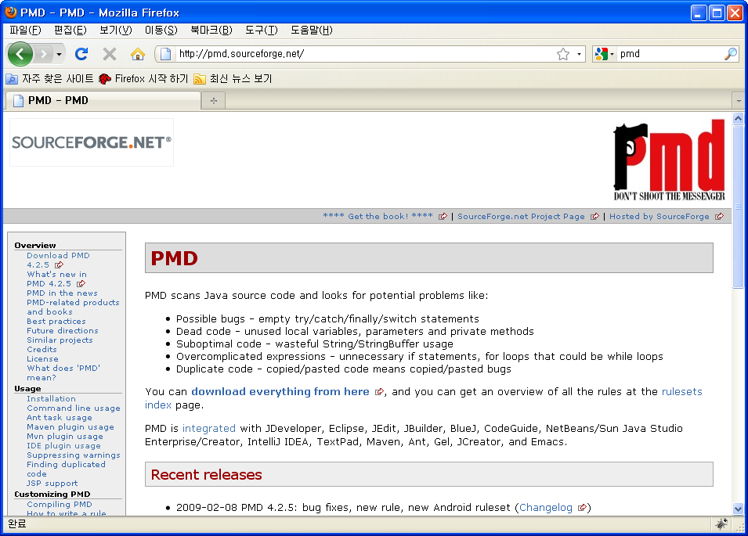
PMD
Update
Officical Site: http://pmd.sourceforge.net
Installation Guilde: http://pmd.sourceforge.net/integrations.html#eclipse

Slide 3
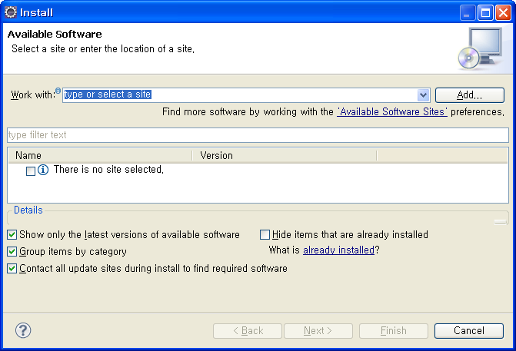
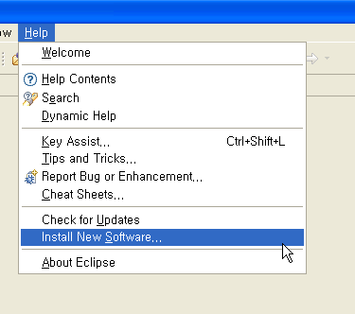
PMD
Install
Menu
  Help > Install New Software...
Install Window
  Work With: > Add

Slide 4
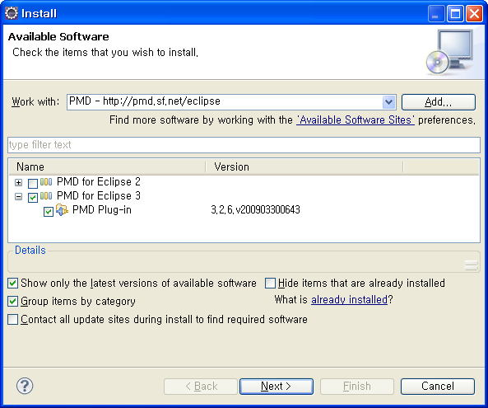
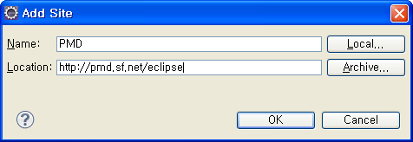
PMD
Add Site
Add Site Windows
  Name: PMD
  Location: http://pmd.sf.net/eclipse
  Check PMD for Eclipse 3

Slide 5
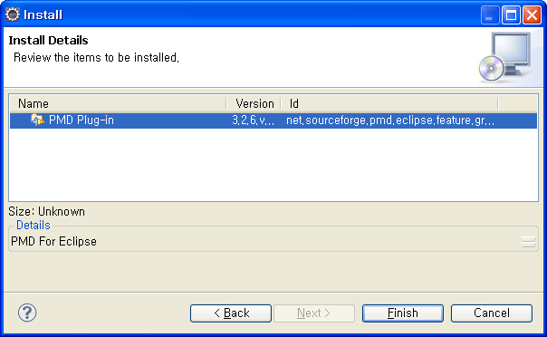
PMD
Install
Install Details Window
Click Finish

Slide 6
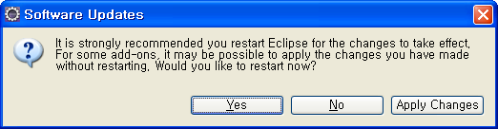
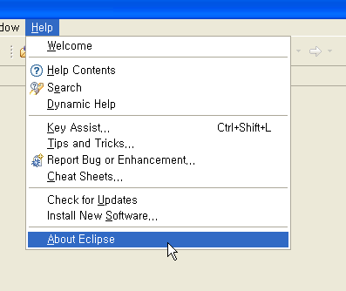
PMD
Software Updates
Software Updates Window
  Restart
Menu
  Help > About Eclipse

Slide 7
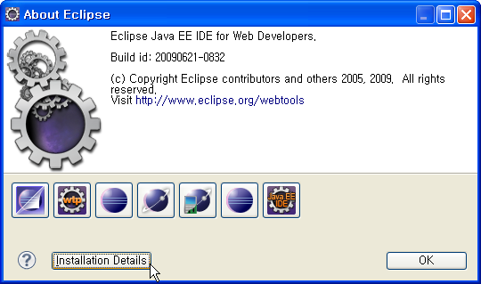
PMD
Software Updates
About Eclipse Window
  Install Details
Eclipse Installation Details Window
  Plug-ins

